Slide 1
Theoretical and experimental physics Large hadron collider
Kurnikov EGor T06-67 Golikova Julia T06-32 national research Nuclear university 2015

Slide 2
FINDINGS
DESIGN ALICE ATLAS CMS LHCb
FUTURE

Slide 3
the most impressing machine. the greatest experiment in human history.

Slide 4
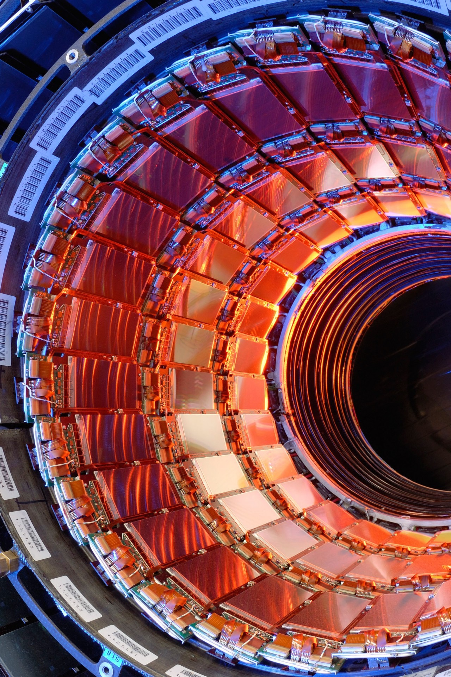
what do you know about LHC?
Collaboration with over 10,000 scientists and engineers from over 100 countries
175 meters beneath Franco-Swiss boarder, near Geneva
Lies in a tunnel 27 kilometers circumference
Total cost = 3.74 billion British pounds
Seven detectors for certain kind of research

Slide 5
1.FINDINGS

Slide 6
aims
Testing the predictions of different physics theories
Addressing some of new questions of Physics
Advising human understanding of physical laws

Slide 7
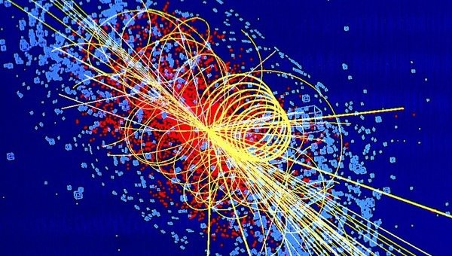
where is the truth?
Particle physics
High-energy Physics
QCD
Standart Model
Higgs Boson
Supersymmetric theories

Slide 8
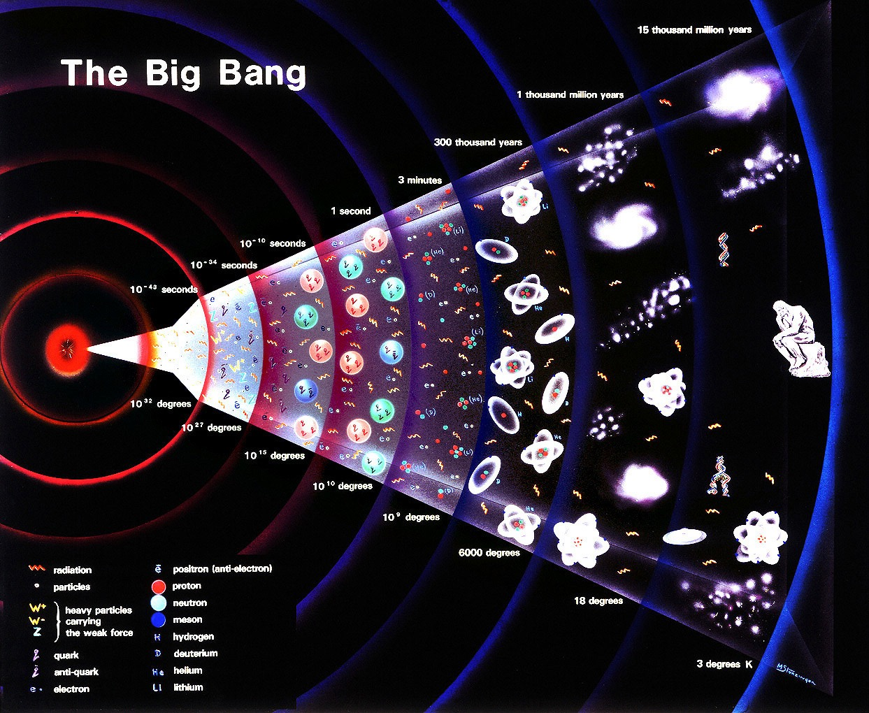

Slide 9
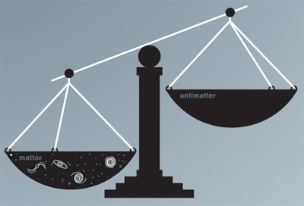
Cp-violation
Why is our Universe made by matter but not antimatter?

Slide 10
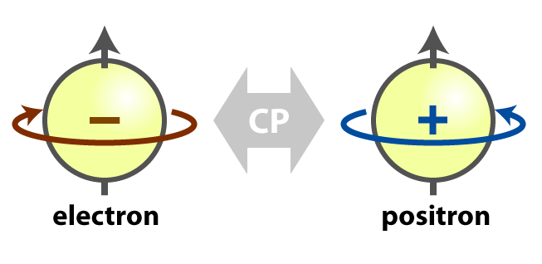
Cp-mechanism

Slide 11
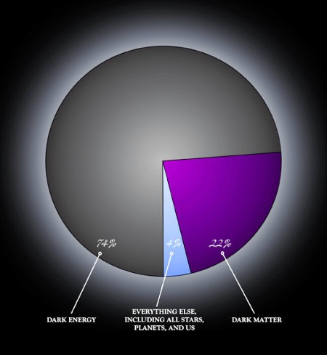
Dark matter and energy

Slide 12
2.DESIGN

Slide 13
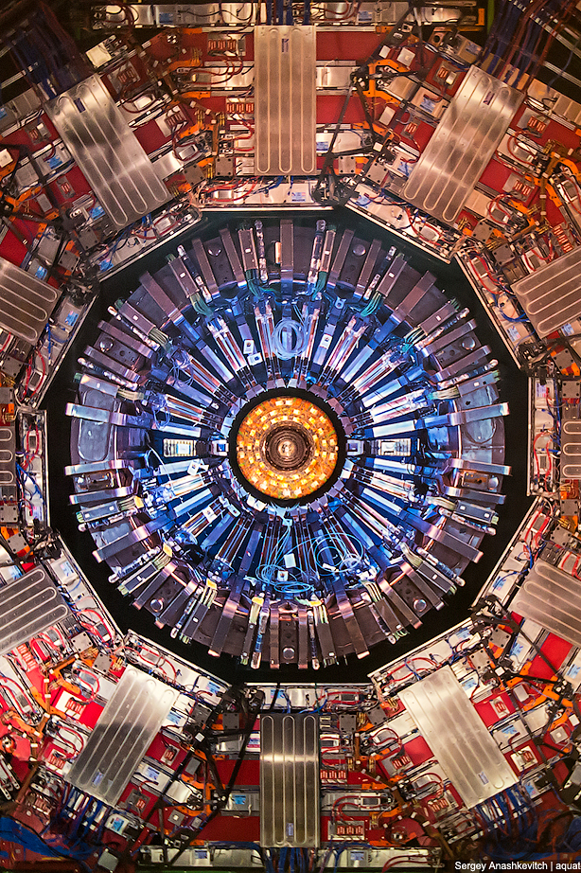
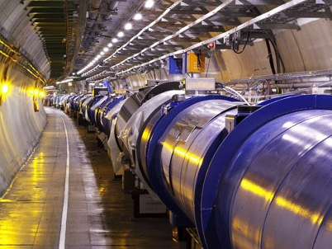
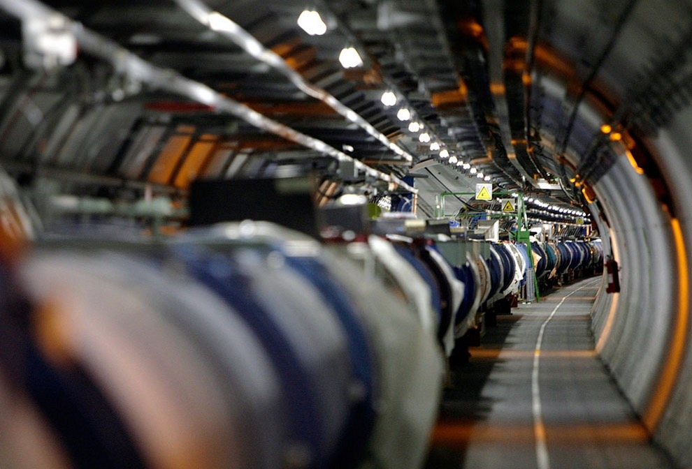

Slide 14
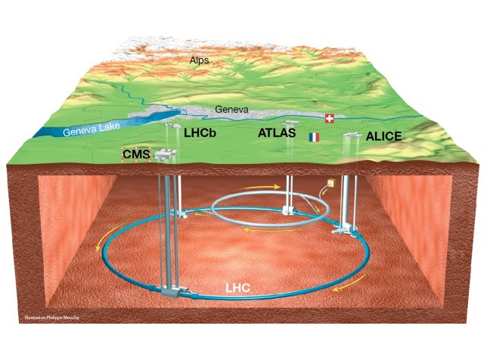
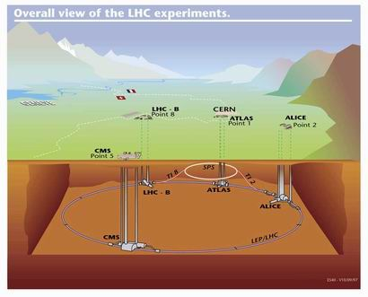

Slide 15
3.FUTURE

Slide 16

very large hadron collider?

Slide 17
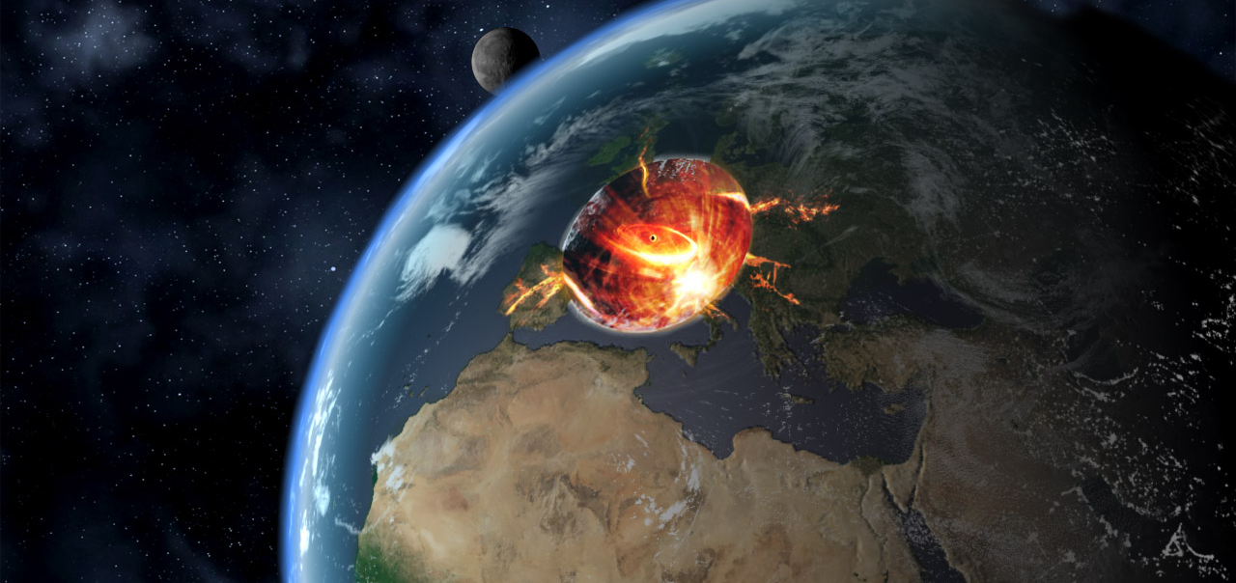
«If the LHC could do this, then so could cosmic-ray collisions».
–LSAG report

Slide 18
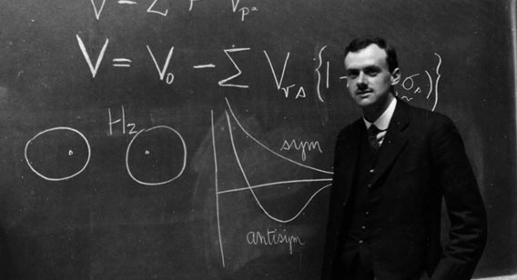
Thank you for attention

